Slide 1

KNOWLEDGE AND CURRICULUM
Unit I - Epistemological bases of education
Dr.V.Regina
Principal ,Asst,Professor of Biological Science
CSI Bishop Newbigin College of Education
No.109, Dr.Radhakrishnan salai, Mylapore, Chennai - 600004

Slide 2
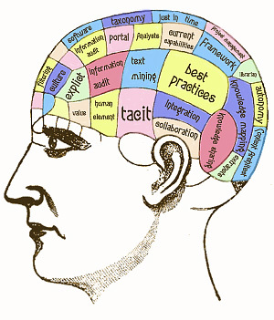
Synopsis
Introduction: Epistemology
Knowledge and its types
Skill and its types
Teaching and its types
Training and its types
Information and its methods of collection
Reasoning and its types
Belief and its types
Differences - knowledge & skill
Conclusion
Suggestive Readings
Teaching and Training
Knowledge and information
Reasoning and Belief
Dr. V. Regina , Principal CSI BISHOP NEWBIGIN COLLEGE OF EDUCATION

Slide 3
Learning Objectives
To investigate the origin, nature, methods and limits
To influence our own theories
Learning Outcomes
It influences students approaches to study and develops problem solving skill
It stimulates thinking styles
Dr. V. Regina , Principal CSI BISHOP NEWBIGIN COLLEGE OF EDUCATION

Slide 4
It is the branch of philosophy that investigates the origin, nature, methods and limits of human knowledge
Our own epistemology influences our own theories of learning.
A teacher creates new knowledge through different approach and design.
It is the science of knowledge or cognition.
Meaning of Epistemology
Dr. V. Regina , Principal CSI BISHOP NEWBIGIN COLLEGE OF EDUCATION

Slide 5
Wisdom
Acquaintance gained by facts
Familiarity to a branch of learning
Acquaintance gained by sight
The fact or state of knowing
Creating or involving
Meaning of Knowledge
Dr. V. Regina , Principal CSI BISHOP NEWBIGIN COLLEGE OF EDUCATION

Slide 6
A posteriori knowledge
A priori knowledge
Dispersed knowledge
Domain(expert) knowledge
Empirical knowledge
Encoded knowledge
Explicit knowledge
Communicated knowledge
Situated knowledge
Training knowledge
Types of Knowledge
Dr. V. Regina , Principal CSI BISHOP NEWBIGIN COLLEGE OF EDUCATION

Slide 7
Skill and its types
Meaning:
The ability coming from one’s knowledge,practice aptitude, ets
Soft Skills
Time management skills
Negotiation skills
Critical thinking skills
Self confidence skills
Business etiquette skills
Goal setting skill
Problem solving skill
Life Skills
Self evaluation skill
Communication skill
Good rapport skill
Managing emotional skill
Understanding of others skills
Thinking skills
Innovative skills
Decision making skills
Team work skills
Stress management skills
Dr. V. Regina , Principal CSI BISHOP NEWBIGIN COLLEGE OF EDUCATION

Slide 8
Characteristics of a Good teaching
Having mastery of their teaching content
Providing a safe environment
Building positive relationships
Monitoring progress and providing feedback
Encouraging students responsibilities
Having high expectation
Acknowledging individual differences
An ability to improvise and adapt to new demands
Using valid assessment methods
Teaching and its characteristics
Teaching is a process of educating a person with theoretical concepts and is a kind of a knowledge transfer between a teacher and a student
Dr. V. Regina , Principal CSI BISHOP NEWBIGIN COLLEGE OF EDUCATION

Slide 9
Induction training
Job training
Safety training
Apprenticeship training
Internship training
Refresher training
Promotional training
Physical training
Computer skills training
Simulation training
Quality training
Professional training
Team training
Training and Its types
Training is the act of increasing the knowledge and skill of an employee for doing a particular job.
Dr. V. Regina , Principal CSI BISHOP NEWBIGIN COLLEGE OF EDUCATION

Slide 10
Surveys
Interviews
Existing data sources
Literature sources
Observations
Documents and records
Experiments
Tallies or counts
Face to face/ phone
Online tracking or market analytics
Social media monitoring
Information & its method of collection
Information is the knowledge communicated or received concerning a particular fact or circumstance or news.
Dr. V. Regina , Principal CSI BISHOP NEWBIGIN COLLEGE OF EDUCATION

Slide 11
Inductive reasoning
Detective reasoning
Conditioned reasoning
Categorical reasoning
Linear reasoning
Abductive reasoning
Backward reasoning
Critical thinking reasoning
Counterfactual thinking reasoning
Intuition reasoning
Reasoning & its types
Reasoning is a process of thinking ,where the individual is aware of a problem and - Identifies, evaluates and decides upon a solution.
Dr. V. Regina , Principal CSI BISHOP NEWBIGIN COLLEGE OF EDUCATION

Slide 12
Belief systems
Religious faiths
Agnosticism
Animism
Atheism
Deism
Determinism
Esotericism
Vague belief
Self-supported belief
Belief beyond reasonable doubts
Belief & its types
Belief is a feeling of certainty that something existing , is true or is good. It is a propositional attitude which cannot be proven scientifically.
Dr. V. Regina , Principal CSI BISHOP NEWBIGIN COLLEGE OF EDUCATION

Slide 13


Difference between
Knowledge & Skill
Theoretical or understanding of a subject
Acquired through learning or experience
Gained from others
It increases with experience
Factual and procedural information
Safety rules
Teachable
Ability to understand and recall
Training or experience of a subject
Acquired through practice or learned behaviour
Developed by self (practiced or learning)
It increases with practice
Proficient and effective use of a person’s knowledge
Arithmetic
Teachable
Ability to perform an activity with proficiency
Dr. V. Regina , Principal CSI BISHOP NEWBIGIN COLLEGE OF EDUCATION

Slide 14


Difference between
Teaching & Training
Provides new knowledge
Teaching fills mind
Stresses on knowledge and wisdom with long times span
Gives extensive domains with limited knowledge in general
Needs effective reciprocal communication
Is in for a broaden area
Theoretically oriented
Knowledgeable people to learn the tools
Training shapes habits
Stresses on skills and abilities with a shorter times span
Gives intensive information about a limited and specific domain
Needs effective physical activity of the learner
Is for a specific area
Practical oriented
Dr. V. Regina , Principal CSI BISHOP NEWBIGIN COLLEGE OF EDUCATION

Slide 15
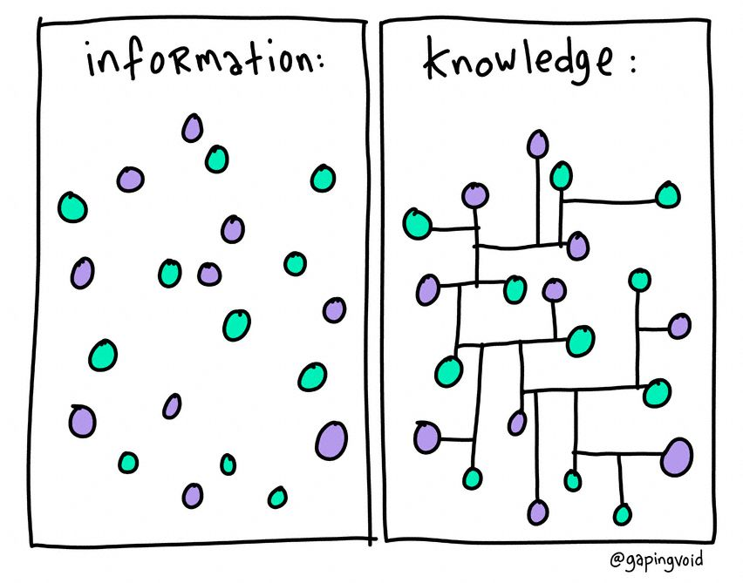
Difference between
Knowledge & Information
It becomes knowledge once we apply it or use it
A more profound conclusion
Knowledge is personal and individual
Involves a personal experience
Knowledge is information with meaning
Actionable information
Devoid of owners dependencies
Data and facts that known are there
A raw data collected through observation
Data in numbers, words, images or sounds
Images can be included
Information is data with context
Processed data
Depends on the owner
Dr. V. Regina , Principal CSI BISHOP NEWBIGIN COLLEGE OF EDUCATION

Slide 16

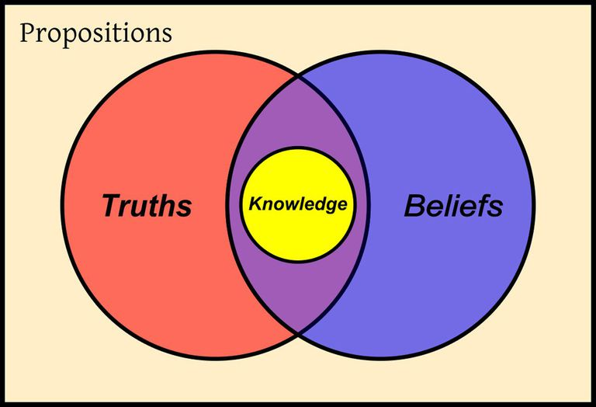
Difference between
Reasoning & Belief
Science (fact)
Evidences/ Arguments
Exercise critical reasoning based upon evidence
Postulate tentative theory
Subject the theory to peer review
Objective
Universal level
Religion
Word of God/ words from the source
Accept the faith
Considered it to be the revealed truth which cannot be doubted
Done
Subjective
Personal level
Dr. V. Regina , Principal CSI BISHOP NEWBIGIN COLLEGE OF EDUCATION

Slide 17
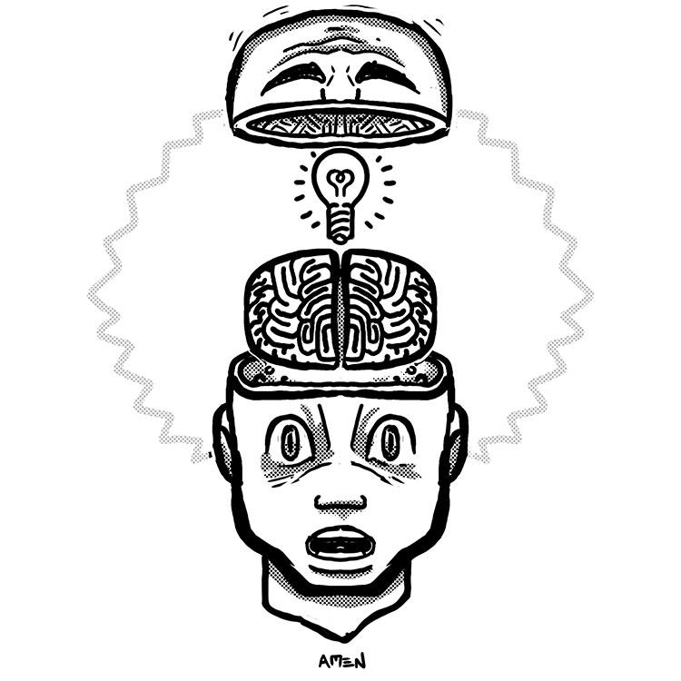
Thus the epistemological basis of education used to describe epistemological positions - vary or depending on , whether it is describing the origin or the acquisition of knowledge. Students can reflect on the existence of “minority cultures” and on the necessity to use multiple learning methods to achieve a mere understanding of the complete problems
Conclusion
Dr. V. Regina , Principal CSI BISHOP NEWBIGIN COLLEGE OF EDUCATION

Slide 18
Suggestive Readings
Barret, Brain., etal (2018) Knowledge curriculum and equity, social realist perspectives Routledge
http://www.mastek.com/careers/learning-development.html
Hoffman, T., “Nine Non Techie skills that hiring managers wish you had”. Computer world, november 12, 2007, accessed July 26, 2010.
Dr. V. Regina , Principal CSI BISHOP NEWBIGIN COLLEGE OF EDUCATION

